Slide 1
Apple WWDC Sentiment Analysis on the publics opinion
Final-year project — Qayiya Mbiza

Slide 2

Agenda
Objective & Data
Methodology
Sample Insights
Models & Evaluation
Limitations
Conclusions & Future Work

Slide 3
Objective & Data
Objective: Analyze public sentiment around Apple’s WWDC events
Data: Social media discussions (sample_150.csv for demo)
Labels: Negative / Neutral / Positive
Ethics: No full raw data in repo; use samples + fetch instructions

Slide 4
Methodology
Preprocessing: lowercase, URL removal, punctuation filtering, tokenization
Models: TF–IDF + Linear SVM baseline; topic hints via LDA
Evaluation: Accuracy, Macro F1 (on full dataset)
Tools: pandas, scikit-learn, matplotlib, seaborn

Slide 5
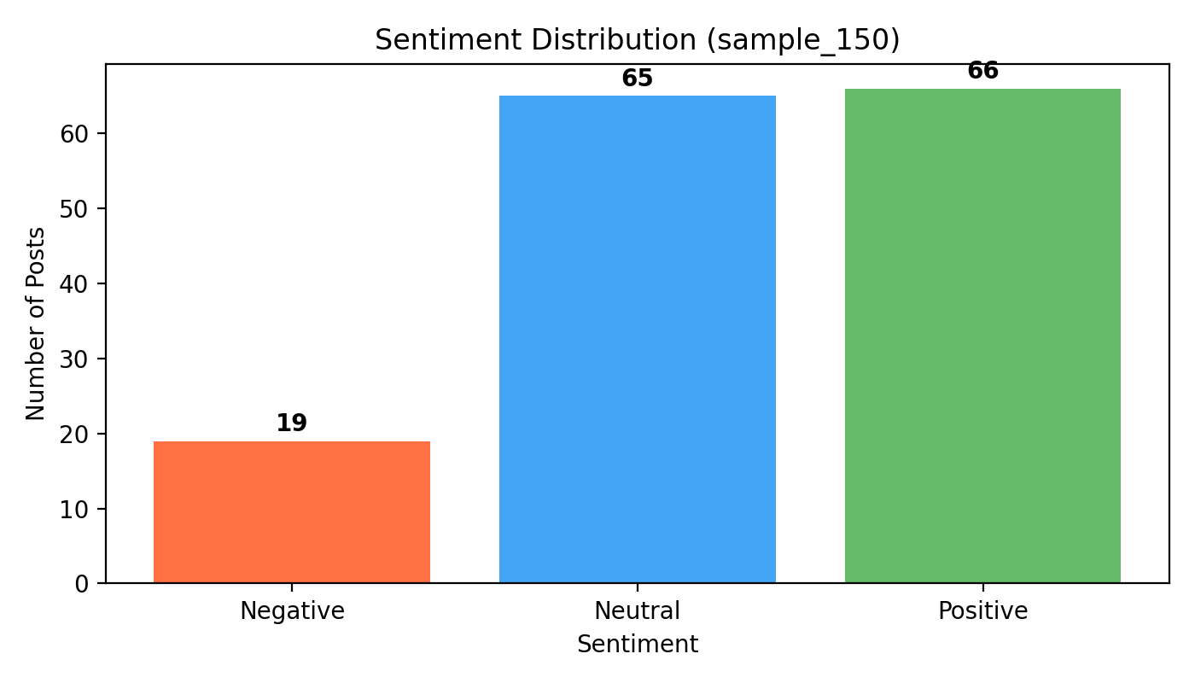
Sample Insights — Sentiment Distribution

Slide 6
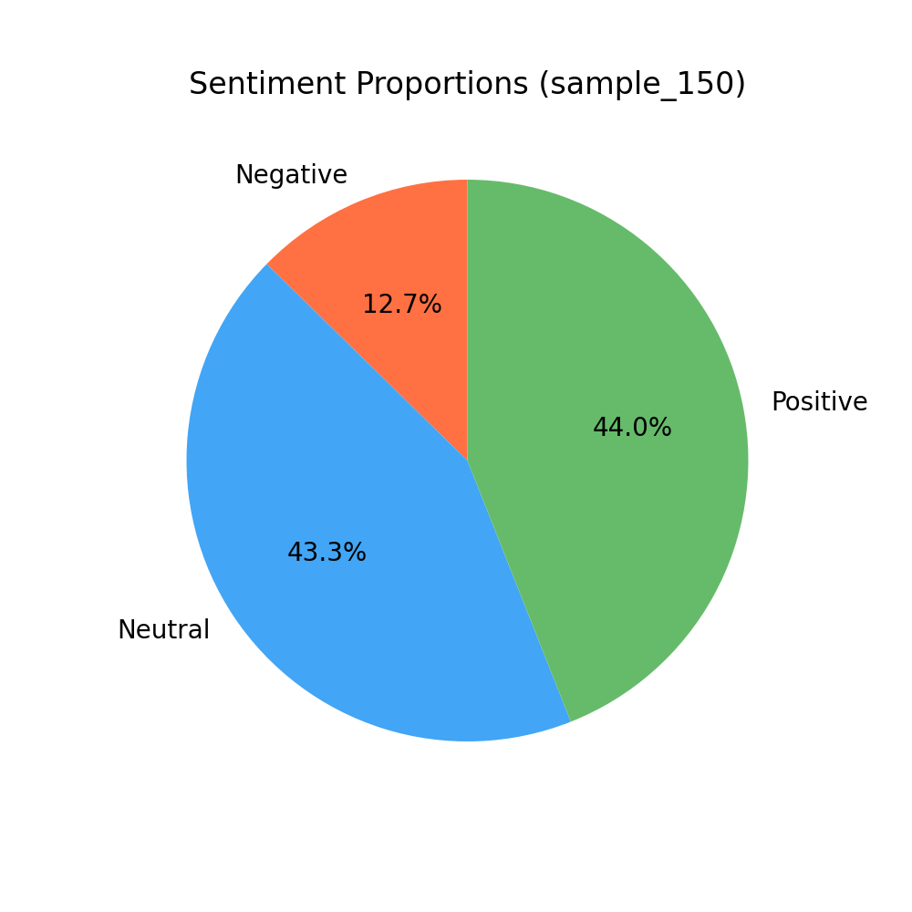
Sample Insights — Sentiment Proportions

Slide 7
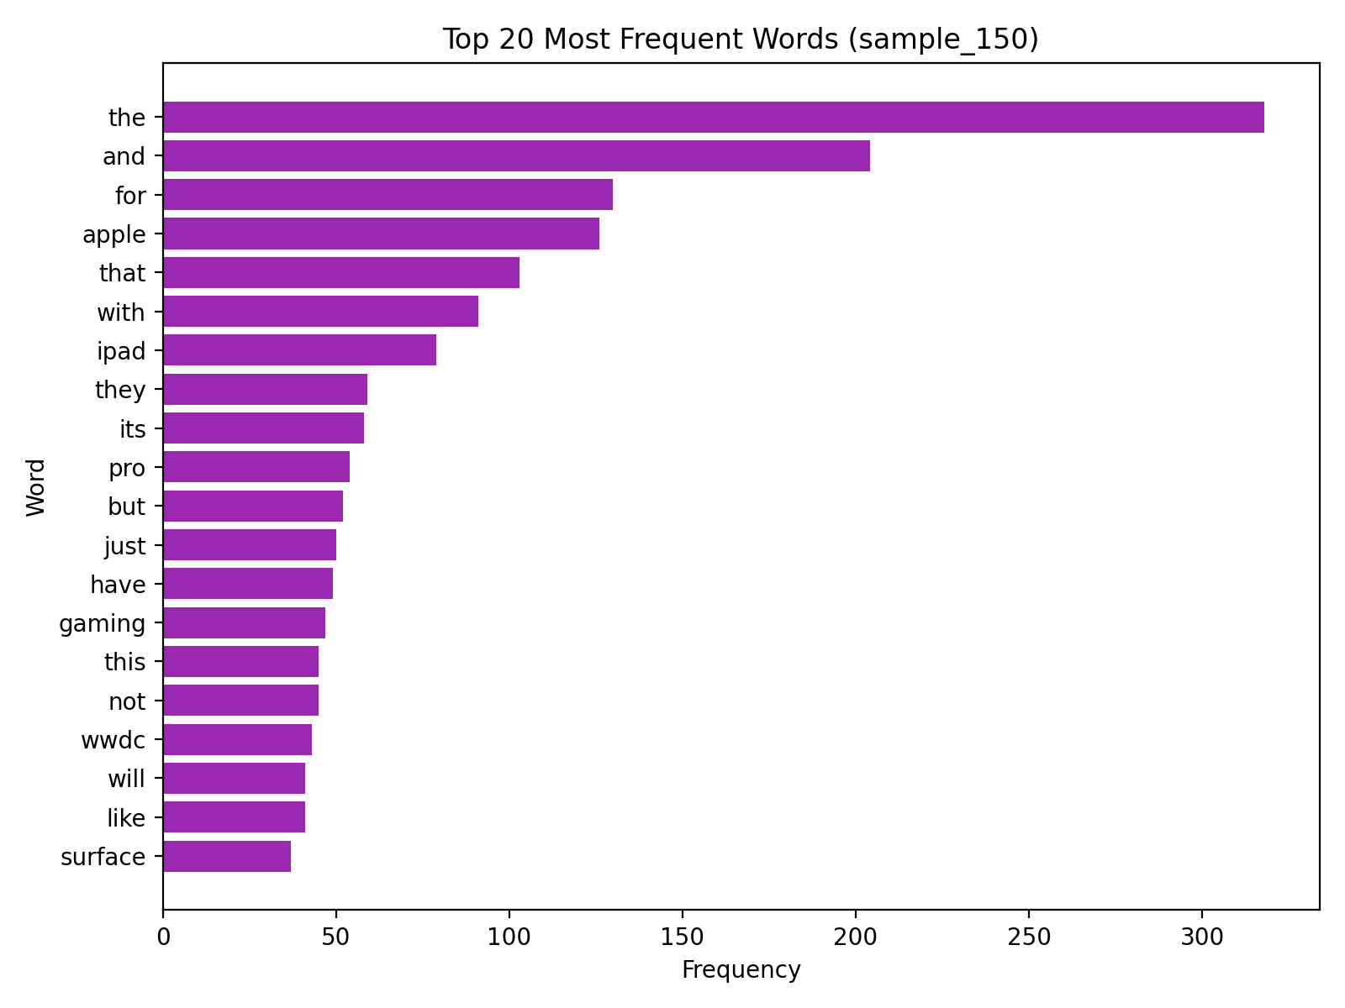
Sample Insights — Top Words

Slide 8
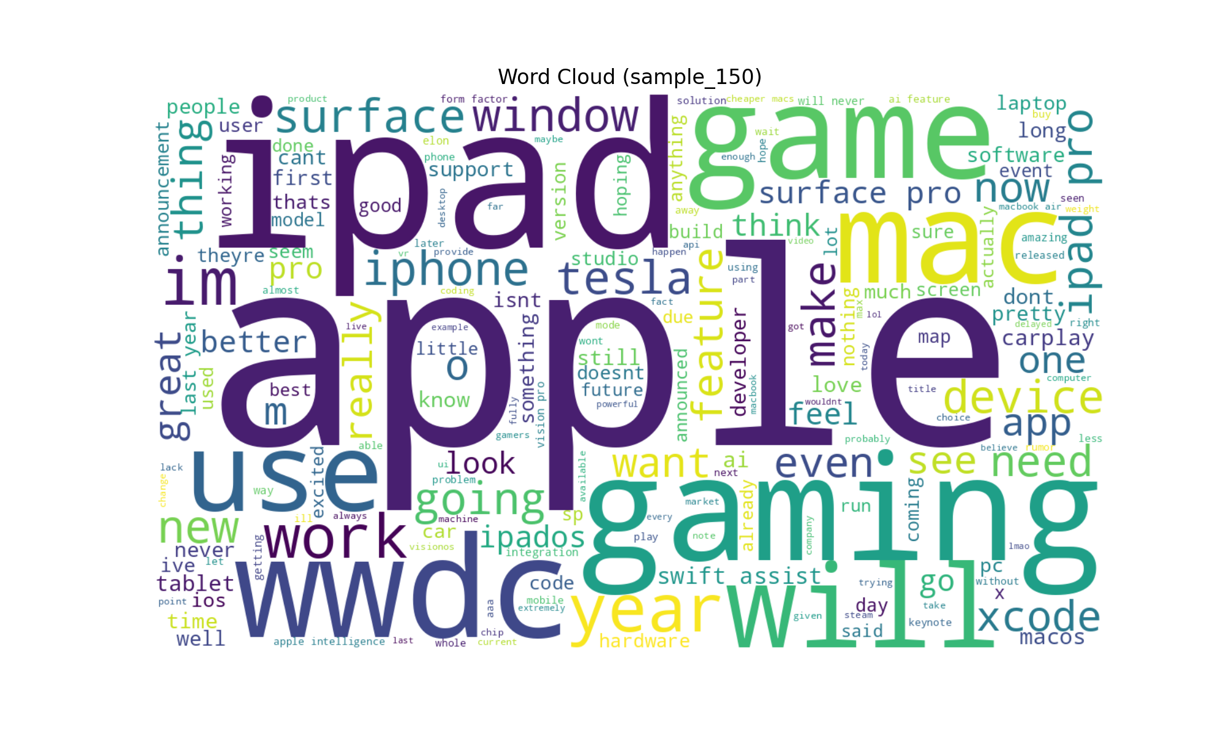
Sample Insights — Word Cloud

Slide 9
Models & Evaluation
Baseline: TF–IDF + Linear SVM (hinge loss via SGDClassifier)
Full-project metrics: computed on 4M+ rows (omitted here for brevity)
Error analysis: inspect misclassifications; confusion matrix, class balance

Slide 10
Limitations
Lexicon-based baselines miss context, sarcasm; dataset scale constraints
API/ToS constraints for raw social media data
Temporal bias around event windows

Slide 11
Conclusions & Future Work
Public sentiment shows measurable patterns around WWDC announcements
Future: transformer fine-tuning, robust evaluation, interactive dashboards

